Slide 1

Your Digital Marketing Partner

Slide 2
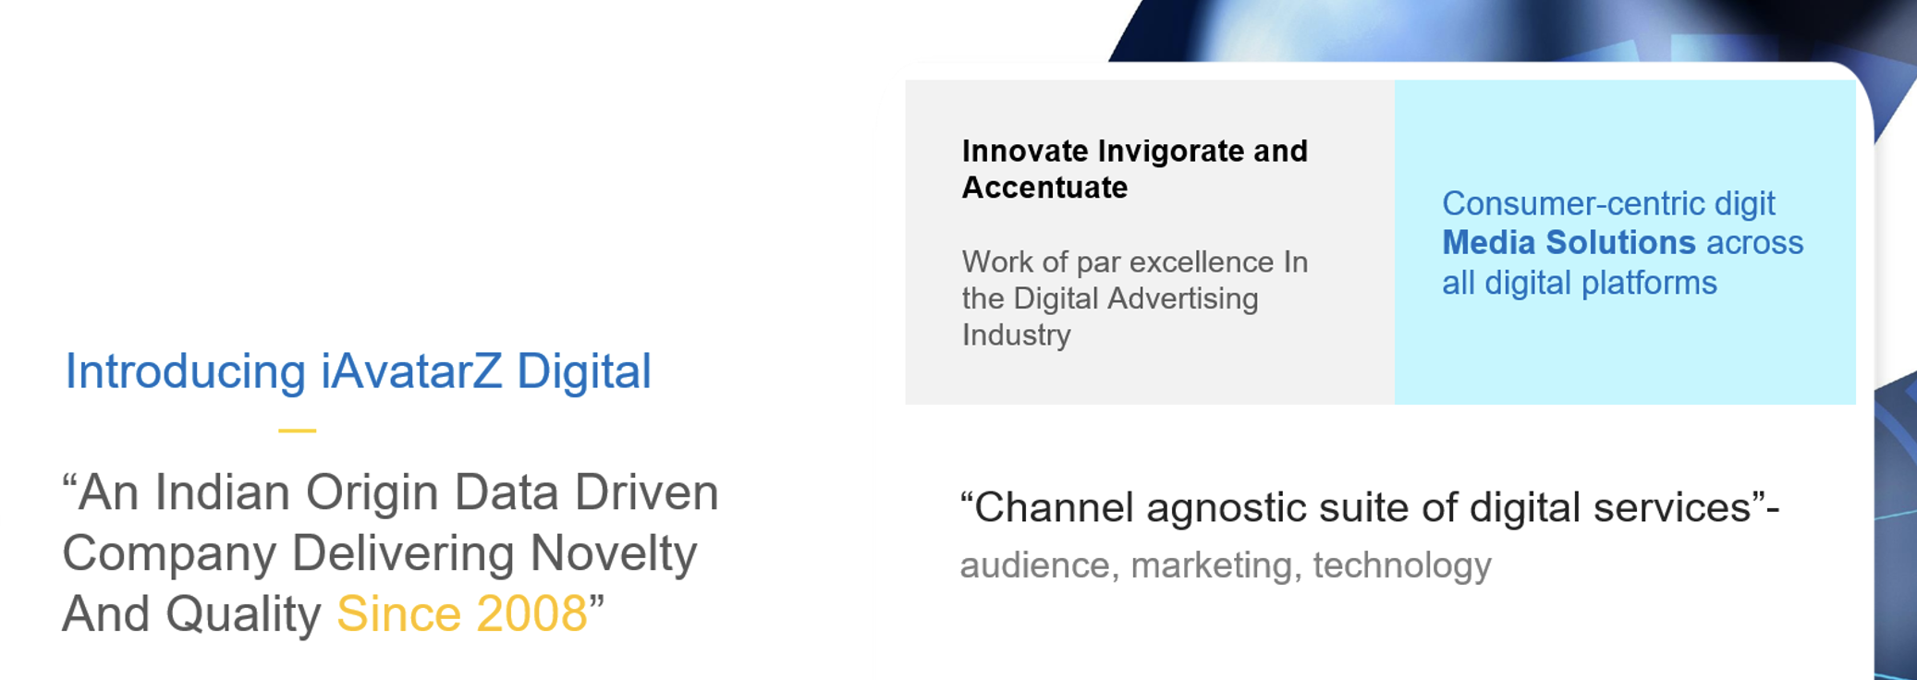

Slide 3
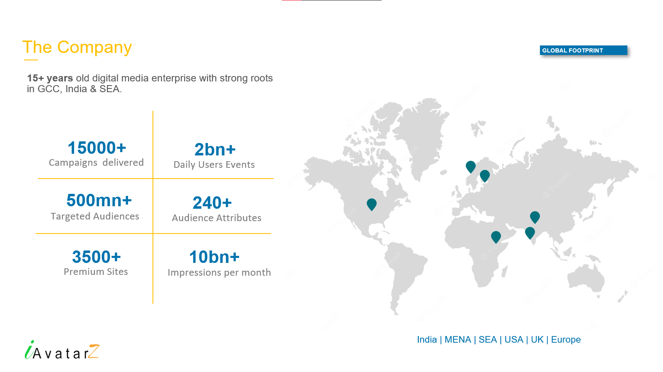

Slide 4

Our Offerings
Display Advertising
Video Advertising
Mobile Marketing
Captivate with visuals - Reach your audience through eye-catching graphics and banners.
Tell your story in motion - Convey your message effectively through compelling video content.
Connect on-the-go - Engage customers through their mobile devices, anytime, anywhere.
Keyword Trend Targeting
Performance Marketing
ABM/BANT Solution
Using real-time search trends to boost brand awareness
Achieve results, not just clicks - Optimize ROI using data-driven strategies for measurable outcomes.
Focus on high-potential B2B accounts
Personalize marketing for success
Boost conversions and ROI"
Our in-house technology & knowledge strengthens Re-Marketing approach by creating the cohorts of the desired audience.
Re-Targeting Solution

Slide 5
Account Based Marketing | Demand Generation

Slide 6
Traditional Vs Account Based Marketing
The ABM sales funnel deviates from the conventional marketing sales funnel by commencing with pinpointing target accounts and concluding with nurturing enduring, valuable relationships.
Attract
Engage
Convert
Identify Target companies
Engage them with personalised campaigns
Land and Expand

Slide 7
Campaign design is dependent on Account design: List Size
One to one/one to very few
(Up to 50 accounts)
Focus on key accounts and people
Customized for each account
Engagement and relationship-focused
SALES ENGAGEMENT
Focus on named and existing key accounts
Customized with some personalization
Engagement and lead-focused
One to few
(Clusters of 50 – 250 accounts)
ROLE OF MEDIA
QUALITY OF DATA
VOLUME OF ACCOUNTS
One to many
(+500 accounts)
Focus on relevant new accounts
Targeted with light personalization
Lead-focused

Slide 8
Defining a targeted list for ABM – it’s a joint venture
Account Prioritisation
  Identify outdated companies
  Create prioritization based on vertical, objectives, product
  Work with clients to identify “star profile” qualities
  Create intent signal recommendation list for account monitoring
  Activation priority given to surging target accounts
  Target account list continuously audited & refreshed
#3
WHITESPACE ACCOUNTS
#2
TARGET ACCOUNT LIST
#1
Client defined target accounts actively displaying signs of intent

Slide 9
Unlock the Greatest Value with a Full Funnel Always On Approach
Always On
Continuous optimization of the customer journey
Full-Funnel - Engagement across every stage of the sales cycle
Automated target account lists
Automated campaign delivery
KPI: Pipeline velocity, marketing ROI
Single Channel Lead Generation
ABM Content Syndication
Target buying committees
Personalized journeys
Targeting decision makers
Siloed channels
KPI: Pipeline creation, Average deal Size
KPI: Leads

Slide 10
1
B2B DATA ACCESS
2
MULTI-CHANNEL CAMPAIGNS
You get access to 23+ million B2B buyers spanning across multiple industries.
We use a Multi-channel Approach and Multilingual Outreach with timely & well-paced leads.
5
EMBEDDED INTELLIGENCE
4
VERIFIED LEADS
3
RIGHT PROSPECTS
Dynamic segmentations with multi lead scoring
We provide you with Sales & Marketing Ready Leads; each qualified lead arrives at your Sales Team with proper intent or decision to buy
We make the best use of Intent Data so that you can reach out to the right prospect at the right time.

Slide 11

Demand Generation
Our passion for the latest technologies, buyer behavior analysis, compliance with data security and regulatory processes ensures that we deliver value and value adds in all our lead generation offerings
MQLs: White Paper Opt-ins, CQ-QQ Leads
HQLs, SQL, BANT Leads
ABM Leads
Double-download Leads
Lead
Opportunity
Customer
Potential customer expressing interest, a valuable opportunity for conversion.
Conversion into Qualified Prospect:
Converting leads into potential customers through effective nurturing and engagement.
After Lead Collection, Customers seek Opportunity, secure Appointments, and drive Demand Generation.
B2B Lead Generation Services

Slide 12










Content Syndication Process Steps
Project Brief: Target Markets, TAL, Persona, Assets, Supressions
Project Execution:
Campaign Execution Used Validated, Mapped Data That Matches The Campaign Specs.
T+1 Delivery After Multiple QA Checks.
Lead Delivery Within 24 Hrs Of Opt-in.
Contact Discovery:
Collation Of Database That Matches The Campaign Specs: Legacy, Subscription, Intent, Bespoke Data
Leads Delivered Through: Converter, Integrate, Lolagrove, Client's Proprietary System And .Xls.
Promotional Creatives:
>Email Design & Content
>Landing Page (Contact Information And Consent)
Leads Shared With Client’s Marketing Team For Quality Assessment
Marketing Creatives Shared With Client’s Marketing Team For Approval
Replacement
Approved Marketing Creatives Received From Client’s Marketing Team.
Fortnightly Review

Slide 13




Shifting the mindset: ABM Metrics that matter
Customer
Journey Phase
Velocity & Frequency of Interactions
On-Target Account Reach/Depth
& Frequency
Return on Ad Spend (Leads, Sales, Retention)
Account Engagement Rate = Engaged accounts / target accounts
The % of accounts that are meaningfully engaged with the organization
Opportunity Rate = Accounts with a new opportunity created / target accounts
The % of accounts with a new opportunity created
Account Win Rate = Accounts won / target accounts
The % of the account list with a new win in a given period of time
Target Account Pipeline = Pipeline created in target accounts
The value of pipeline created with target accounts
Bookings or Revenue = Value of new closed-won deals with target accounts

Slide 14

Our Global Coverage
110 Mn
29 Mn
7 Mn
Contacts
Accounts
C-Suite Executives
19 Mn
23 Mn
29 Mn
IT Contacts
Sales & Marketing
contacts
Director & VP
contacts

Slide 15
GLOBAL B2B DATABASE
Country | US/CA | EMEA | GERMANY | BENELUX | NORDICS | SOUTH AFRICA | AU | NZ | SINGAPORE | HONGKONG | MALAYSIA | PHILIPPINES | THAILAND | VIETNAM | INDONESIA | KOREA | JAPAN
Company Size
10000 | 900698 | 147624 | 65457 | 15830 | 13368 | 1345 | 880724 | 44823 | 11434 | 9062 | 318760 | 480724 | 115113 | 105348 | 407167 | 82690 | 19889
5000 to 9999 | 3922793 | 590507 | 261830 | 63321 | 53478 | 5382 | 110352 | 93367 | 45736 | 36248 | 76786 | 110352 | 26465 | 30638 | 127890 | 73967 | 83348
2500 to 4999 | 3272311 | 492588 | 218412 | 52821 | 44613 | 4490 | 205654 | 82856 | 38153 | 30227 | 171352 | 205654 | 25490 | 32435 | 157375 | 49854 | 72847
1000 To 2499 | 1817800 | 273658 | 121340 | 29345 | 24784 | 2494 | 110201 | 99389 | 21196 | 16798 | 95012 | 110201 | 69302 | 33890 | 15620 | 52539 | 59367
500 to 999 | 1309235 | 197034 | 87365 | 21128 | 17845 | 1796 | 132189 | 81145 | 15261 | 12095 | 103208 | 132189 | 32890 | 41527 | 143772 | 52452 | 41140
100 to 249 | 872700 | 131354 | 58243 | 30528 | 11895 | 1197 | 156209 | 98590 | 10174 | 8063 | 101151 | 156209 | 49678 | 43167 | 8970 | 55135 | 41576
1 to 99 | 1891085 | 122001 | 126224 | 13083 | 25777 | 2595 | 298076 | 86031 | 22049 | 7488 | 204399 | 298076 | 81693 | 113321 | 12700 | 153120 | 20086

Slide 16
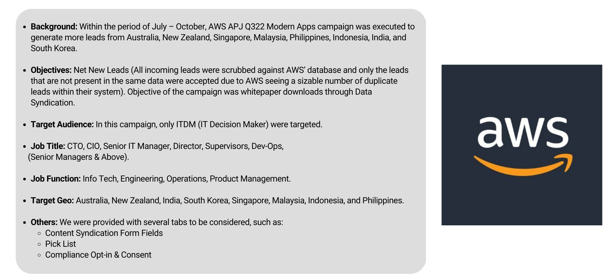
Aws Case Study
Leads Delivered:- 4,250

Slide 17

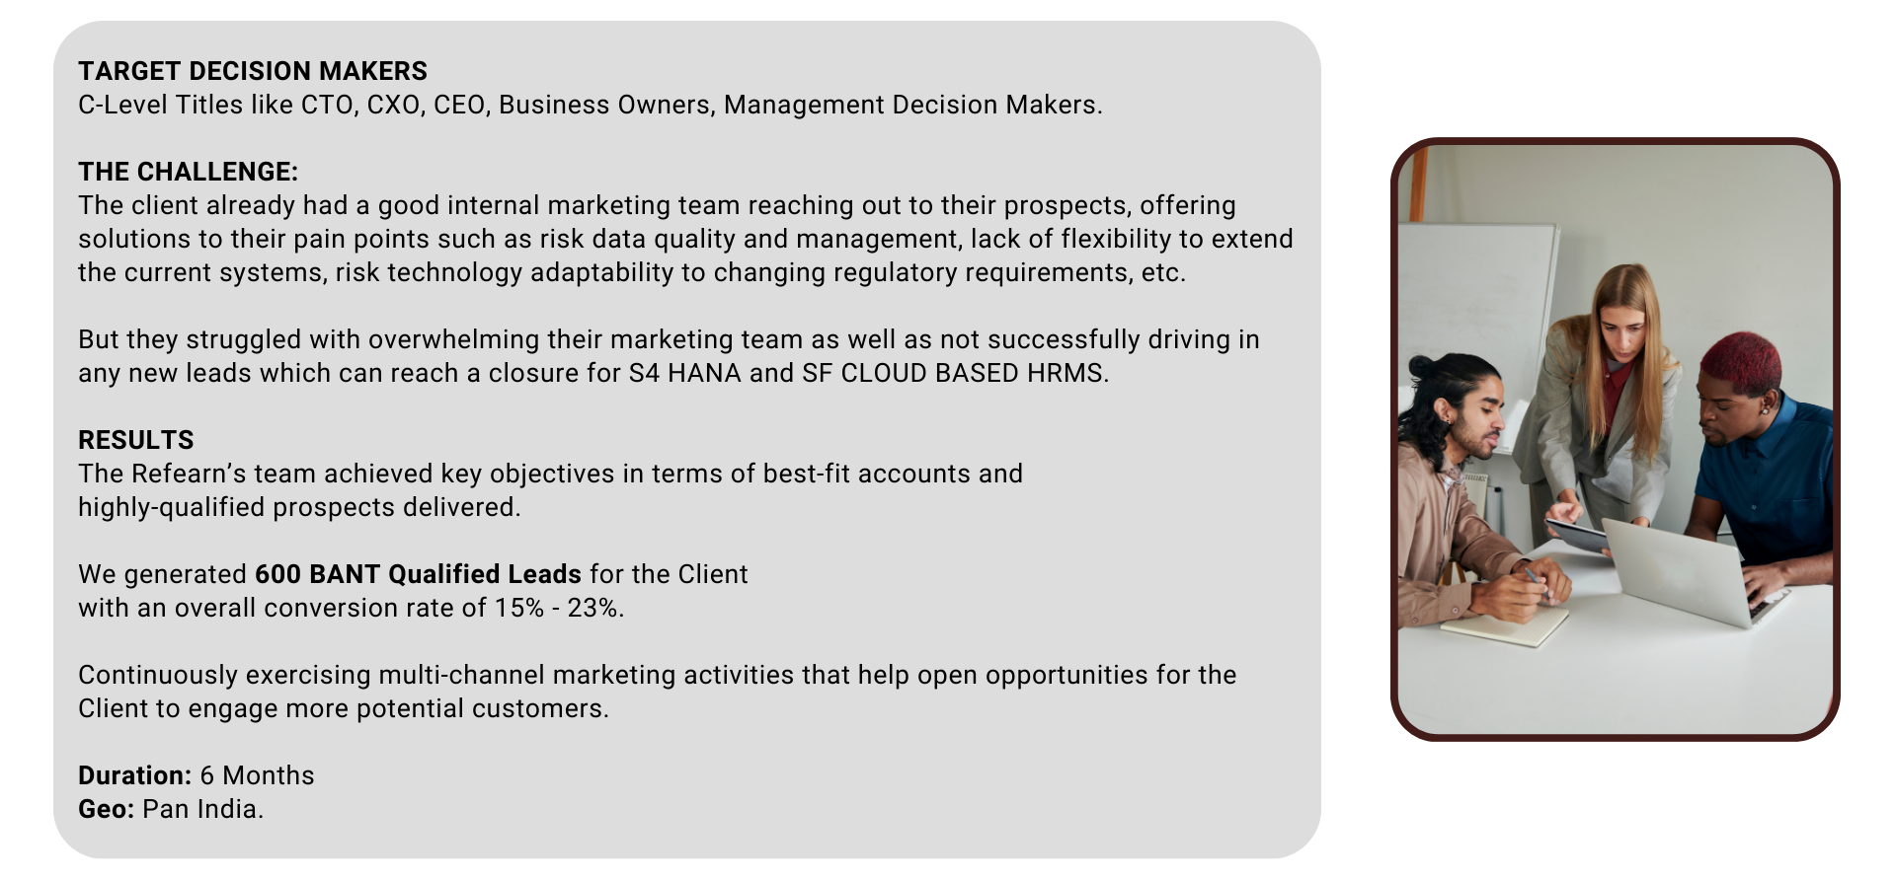
BANT Leads for SAP

Slide 18

MasterCard
Background : Within the period of October- December, MasterCard campaign was executed to generate more leads from Australia and Japan.
Objectives :Objective of the campaign was whitepaper downloads through Data Syndication.
Target Audience : Managers and above
Customer Type: Local, Regional and Global banks; Money Transfer Operators, Payment Service Provider, Remittance Service Providers, Marketplaces
Job titles: Payments Product Manager, Remittance Product Manager, Cross-Border Payments Product Manager, Cash Product Manager, Product Manager, Head of Product Management, Retail Banking Head / Consumer Banking Head, Transaction Banking Head, Treasury, Cash Management, Payment Partnership, CEO/Founder, COO
Target Geo : Australia & Japan
Leads Delivered:- 3000
Duration:- 3 Months

Slide 19

JP MORGAN CHASE
Objective - To create brand awareness and consideration among IT communities in India
TG- IT & Software Developers, Programmers, ITDM etc.
Duration- 3 Months
Geo- India
Delivered Impressions-46 Million
Achieved CTR-0.32% CTR
Approx. 80k candidates redirected to client’s LP
Approx. 2000 leads generated

Slide 20

AMERICAN EXPRESS
Objective - To generate quality leads among Business Professionals
TG- Business Professionals ,C-Level, Entrepreneurs, Senior Level, Frequent Travellers etc.
Duration- 3 Months
Geo- India
3000 Leads generated

Slide 21




Brands we worked for

Slide 22
Let’s Discuss…

